Slide 1
Vanscoy Early Learning Center
Our Journey In Play and Exploration

Slide 2
Nature in our environment

Slide 3
Adding soft and cozy spaces

Slide 4
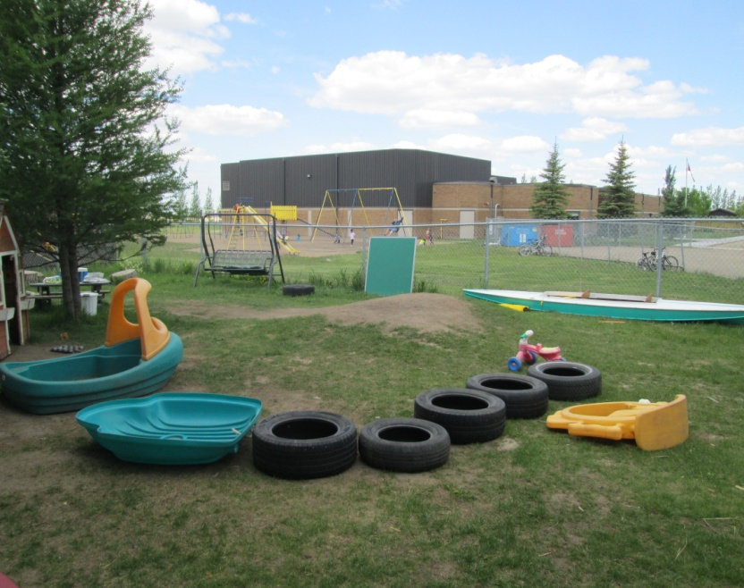
Outdoor Environment

Slide 5
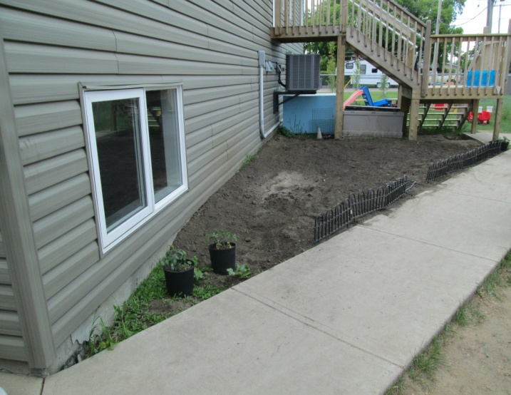
Plants and Trees

Slide 6
Spaces that are pleasing to the eye

Slide 7
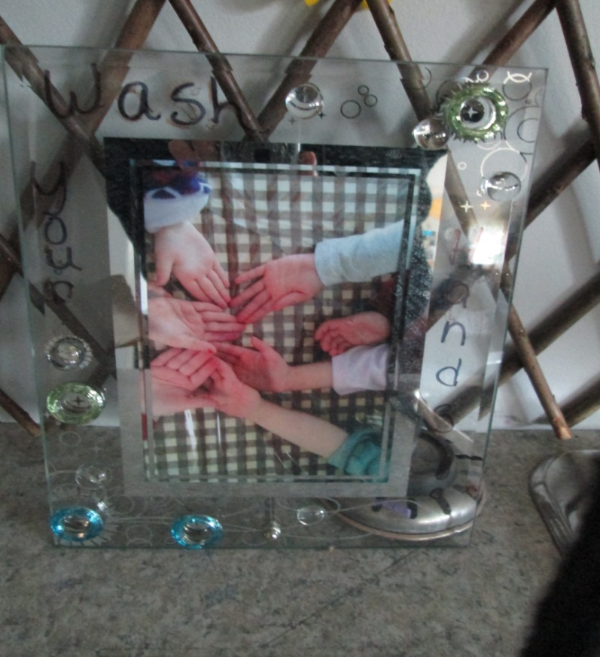
Real life objects in photos

Slide 8
Sensory fun

Slide 9
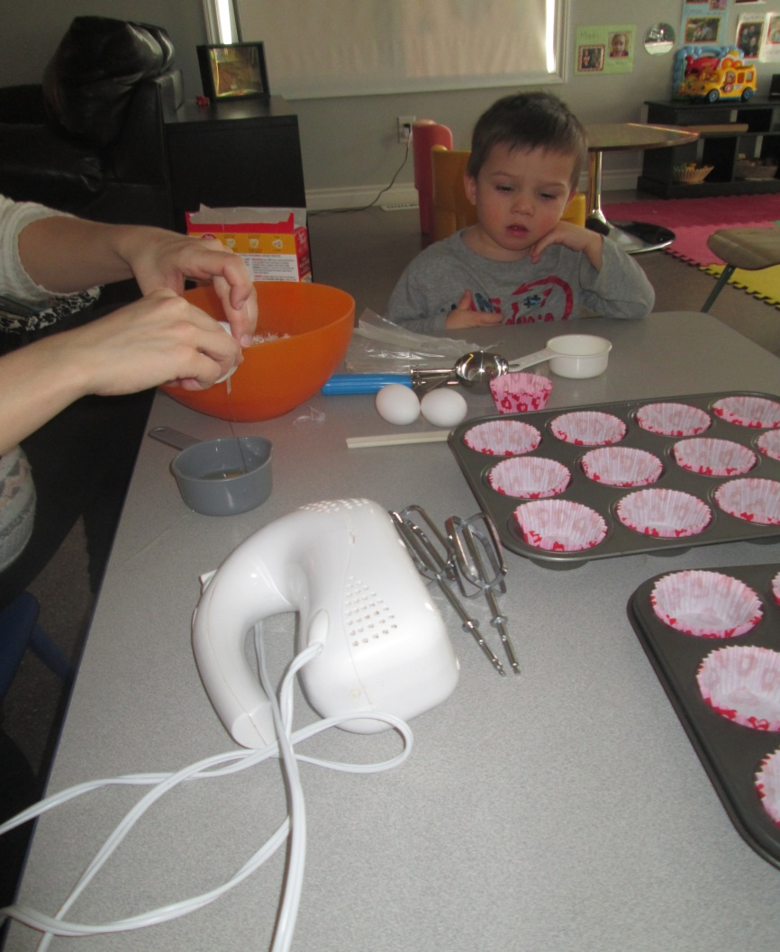
Responding to children’s interests
Red Riding hood baking
Fun with worms!

Slide 10
Toddler Room The Toddler room is a calm relaxing area for children to learn and play using many sensory activities.

Slide 11
The Dragonflies (ages 3-4) The preschool age children have a very calming environment. Essential Learning experiences are important areas of focus. This group uses invitations and projects to encourage learning.

Slide 12
Spiders ages 4-5/Scorpions ages 6-11 The Spiders experience unique invitations to encourage all domains of Essential Learning Experiences . Documentation is key for families to understand how the children are learning in this unique environment. Scorpions enjoy exploring and learning based on their play. They are given the freedom to learn and explore their interests. Nature is a large part of this curriculum.

Slide 13
Essential Learning Experiences
Physical
Intellectual
Spiritual
Social Emotional

Slide 14
THE ICE PROJECT BY Kara and Andrea

Slide 15
The Beginning
The project began while on a walk in the neighborhood with the children. They started stepping and stopping on a frozen puddle and while doing this they started asking questions about the ice. When we arrived back at the daycare the children and staff designed a project web. They talked about ice and how it is made and used in ice sculptures and ice rinks.

Slide 16
Ice in Pails
The following days of the project turned into children freezing ice in pails and balloons to make ice sculptures
After the ice was frozen in the pail we took tools outside with us and the kids made their own project. Some of the children smashed the ice

Slide 17
Ice Fun At Winterfest
Brrr cold
Fun with friends

Slide 18
The project was concluded with a web, pictures and jot notes posted in the classroom for other staff, professionals and parents to view.

