Slide 1
The Baby Project
Conducted and prepared by:
Melanie Gamble and Marcia Ernst
at the
Vanscoy & District Early Learning Center

Slide 2
Introduction
Teachers/staff involved included: Melanie, Marcia, Dawn, and Andrea
This project involved 15 – 20 children between the ages of 3-5 years old. The project was carried out on a time-allowance basis. Meaning, that activities were carried out as time would allow, as each adult involved in the project had different job responsibilities and work schedules. Our center utilizes weekly themes. It was our idea that we would continue with our themes based approach in the mornings and do our project based activities in the afternoons. This became rather challenging for programming to have two separate topics going at the same time; therefore we adapted our themes to fit our project.
The baby project was conducted at the Vanscoy & District Early Learning Center, in the Dragonfly room (preschool). The project was ongoing throughout the months of Jan ‘12 – April ’12 as time would allow.

Slide 3
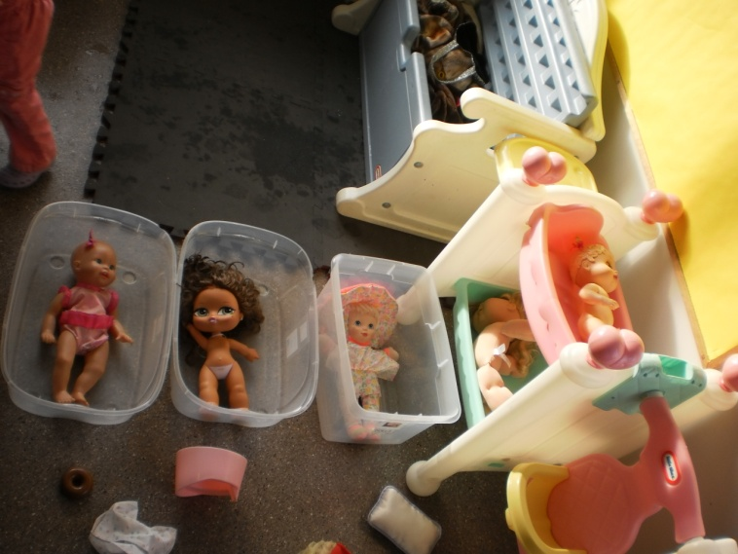
The Beginning
The topic of this project was chosen through observation of the children’s interests. The focussing event occurred when the children were playing with their dolls and dialogue led them to bathing their babies.
We followed up with a topic web with the children. We discussed what the children already knew about the topic: babies wear diapers cause they don’t know how to use the potty; they have “suckies”; they are small with “mushed” up faces; moms and dads take care of them; ending with questions about what they would like to learn: Does mom lick the baby to clean it? What does a baby eat?; If they can crawl, if they can walk; etc. All knowledge and questions were recorded in the children’s web.
We then developed a curriculum web based on the children’s knowledge and questions. This was also recorded on paper in the form of a web. There was no clear teacher expectation as this approach was new in the sense that staff had not fully experiences such an approach. The teachers remained open to new directions and were also prepared for the possibility that the project would halt due to lack of interest.

Slide 4
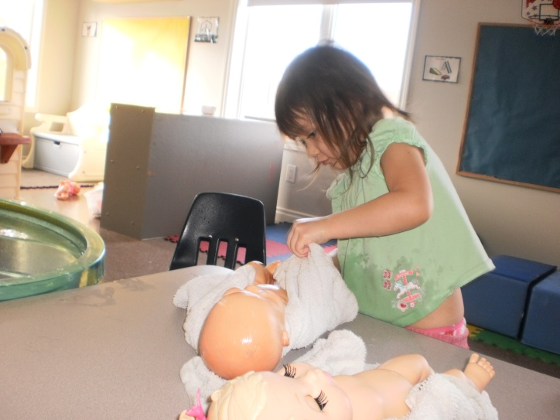
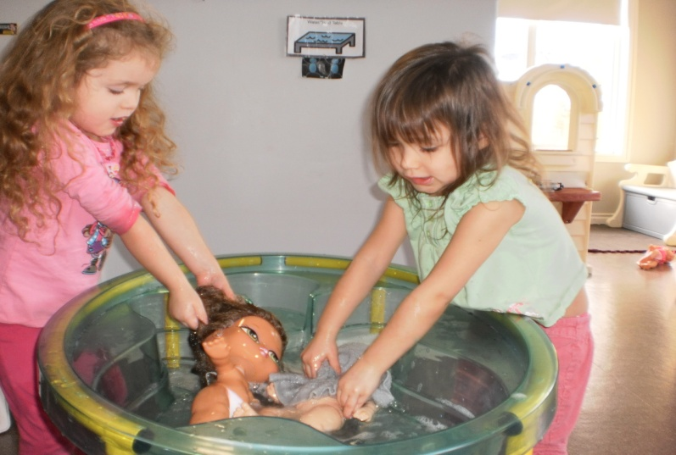
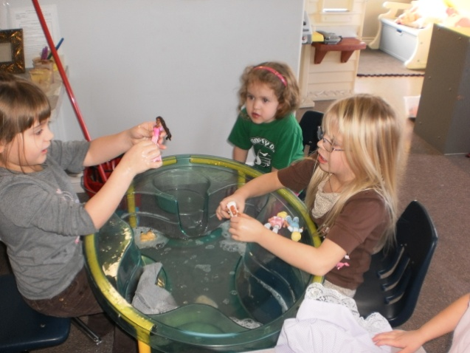
Our observations

Slide 5
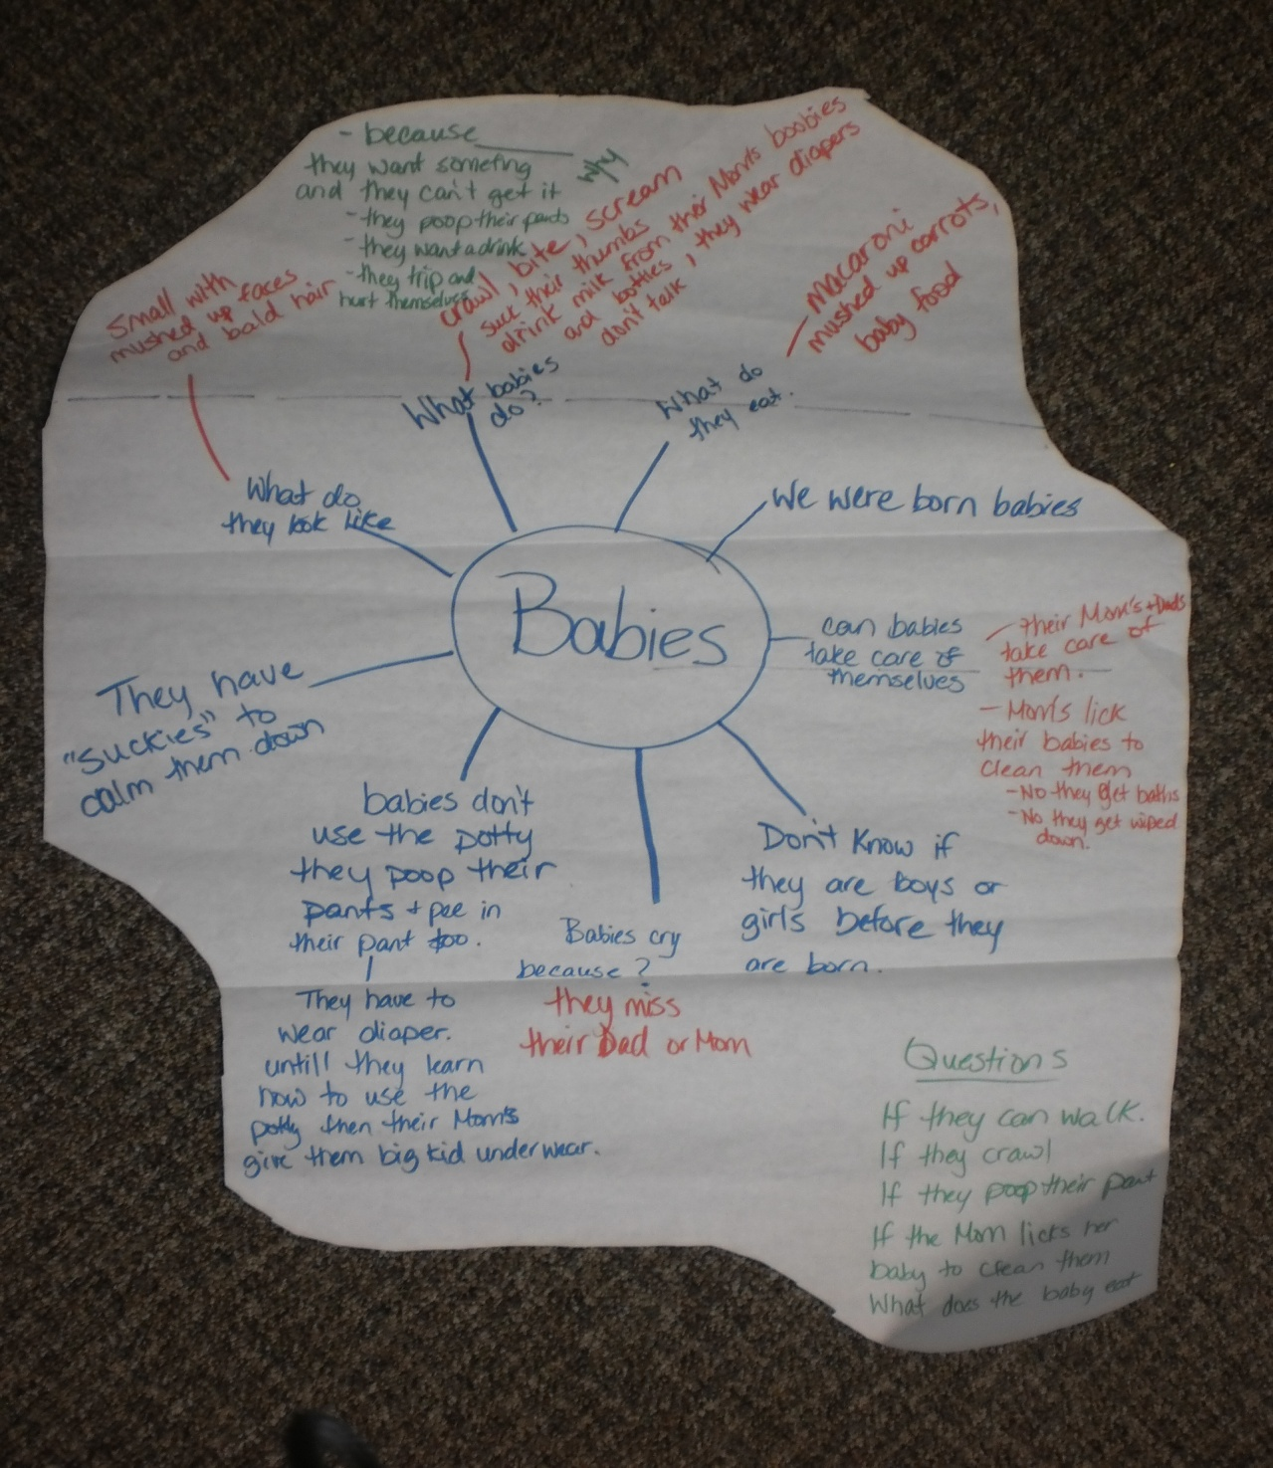
The children’s Web
Together we created a web of what we know and what we want to learn

Slide 6
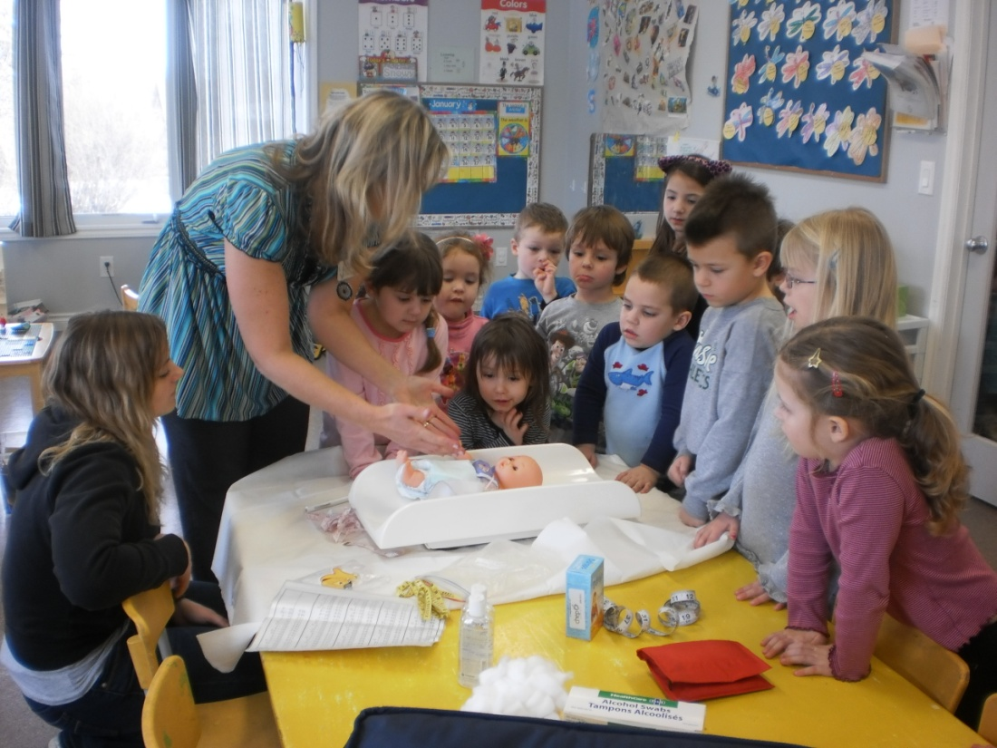
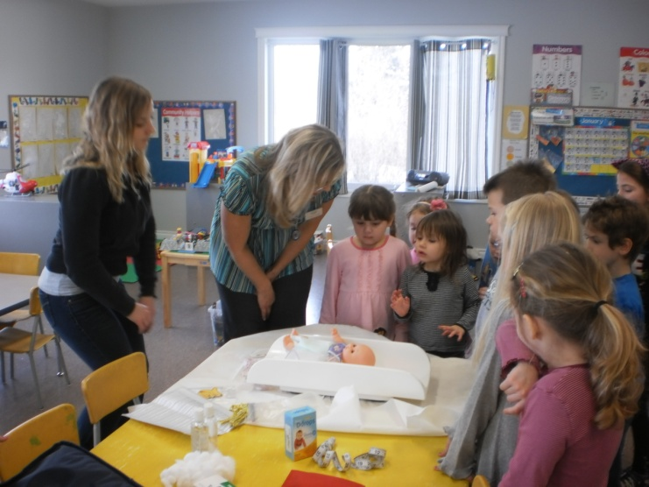
Investigations
Investigations began with a visit from our local Public Health Nurse. The nurse came with supplies needed to give a new baby a routine check-up, showing the children how the babies were weighed and measured. There was also discussion and demonstration on how to properly handle a baby and why.

Slide 7
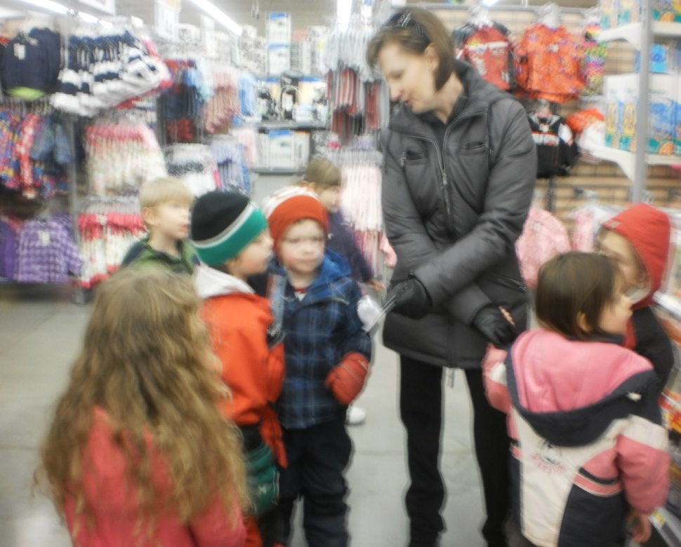
The Baby Department in Wal-Mart
Our next outing was a visit to the local Wal-Mart to show and discuss with the children what babies need to be cared for. We purchased newborn diapers to be used for the children’s dramatic play.

Slide 8
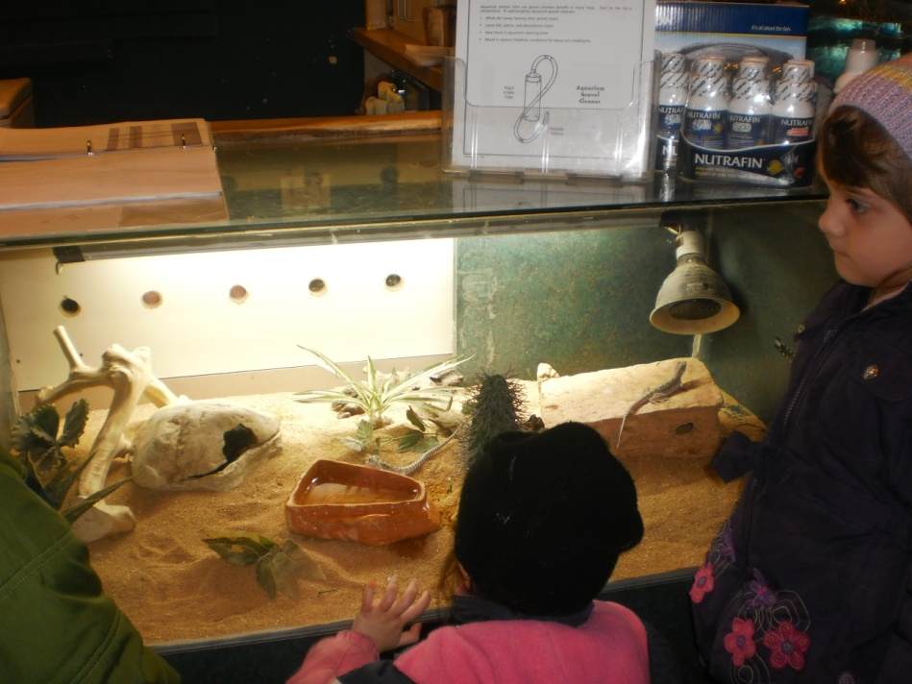
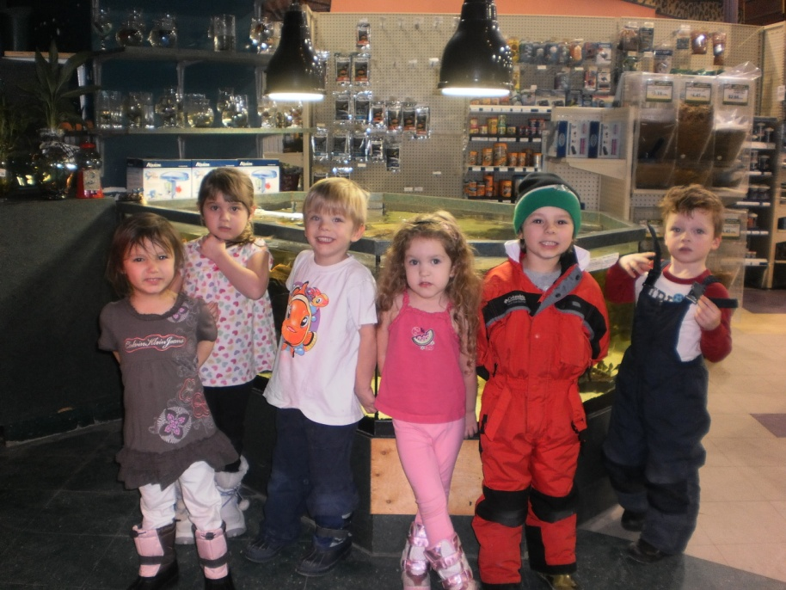
A visit to Petland
While we were at Petland the staff became very excited as they found eggs under a rock in one of the gecko pens. The children each had an opportunity to look at the eggs and learn about how long it take these to hatch.
The visit to Petland exposed the children to the different types of animals and led discussion around animal babies which led into our next theme, “Baby Animals”.

Slide 9
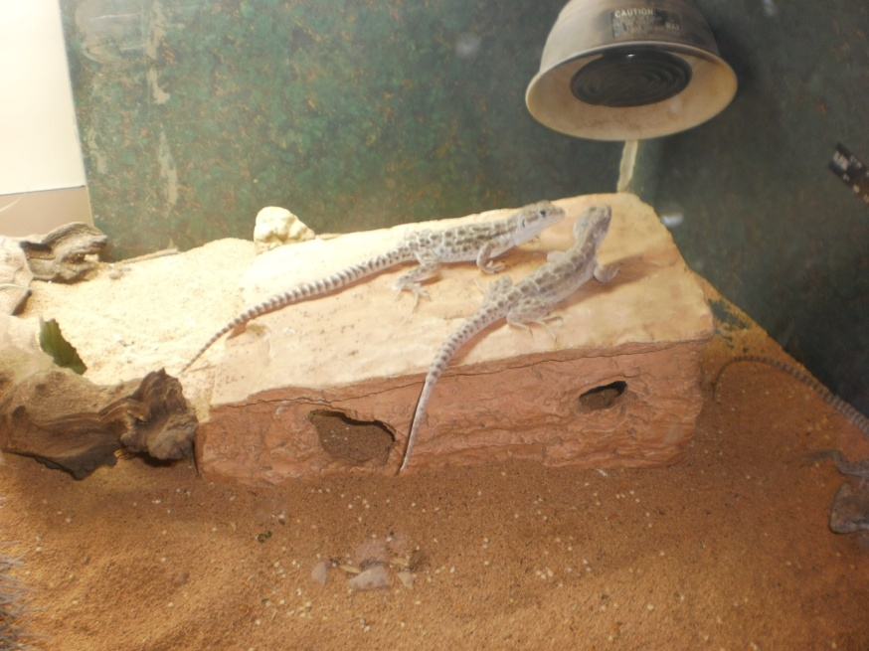
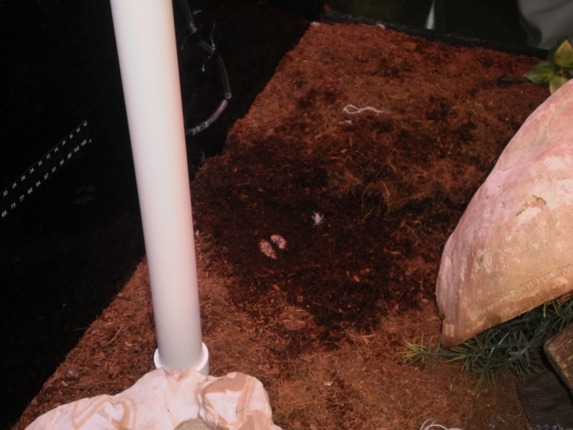
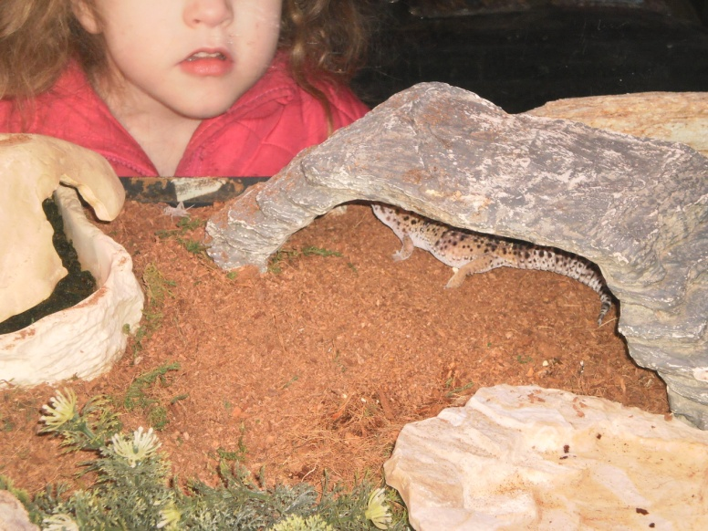
petland
Finding the gecko eggs

Slide 10
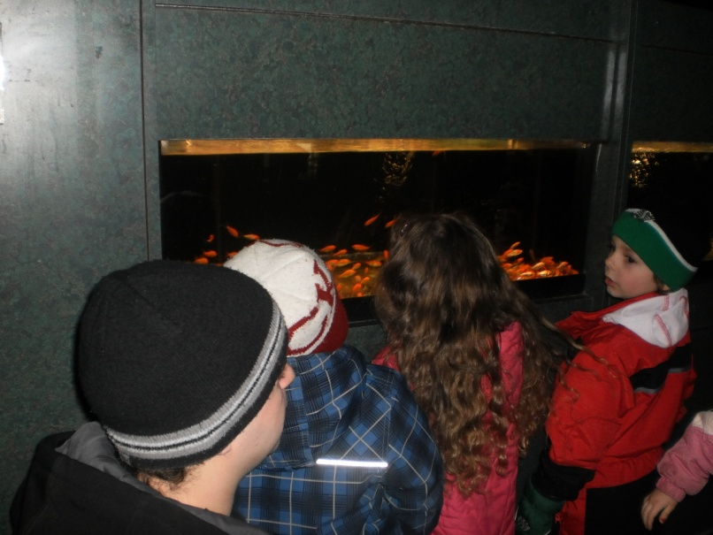
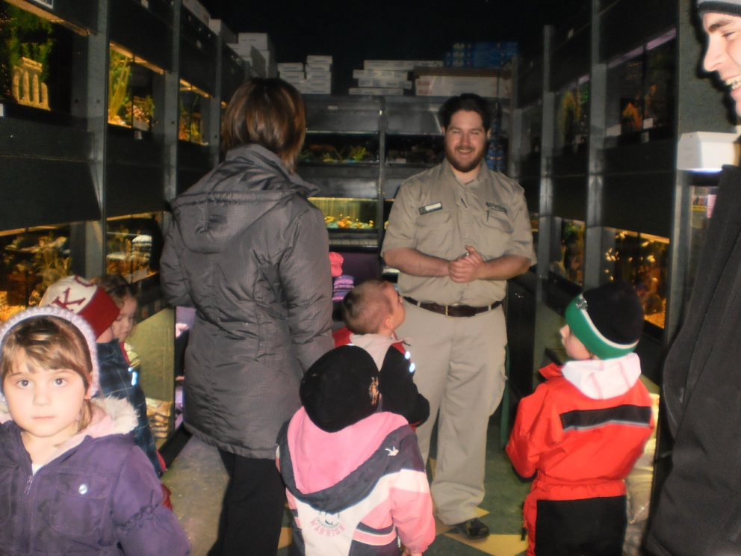
More petland

Slide 11
Daily discussions occurred with the children surrounding each planned activity. I.e. Where do babies come from? (born or hatched) Who’s mommy, whose daddy? (Penguin activities) Baby Baths (cats lick their babies, birds in dirt, pigs in mud, babies in bath) what do babies eat? (Milking projects, baby food making and tasting) How do different kinds of babies communicate (animal sounds games, babies crying).

Slide 12
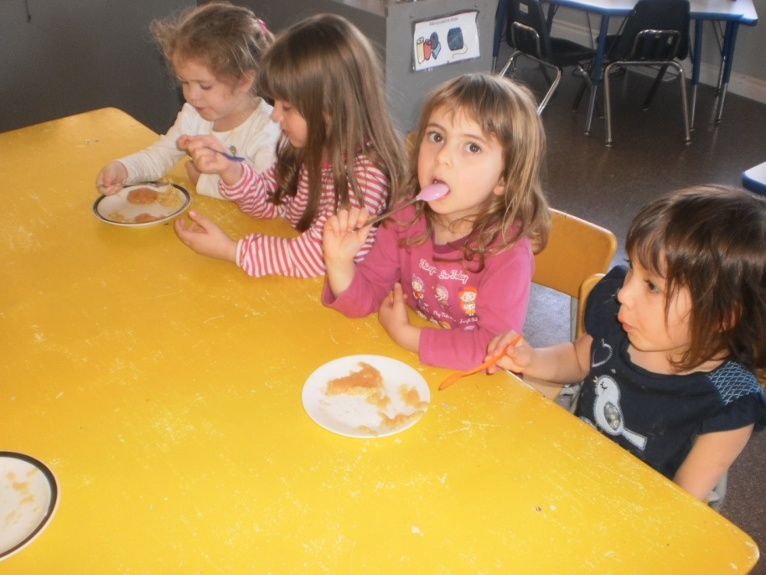
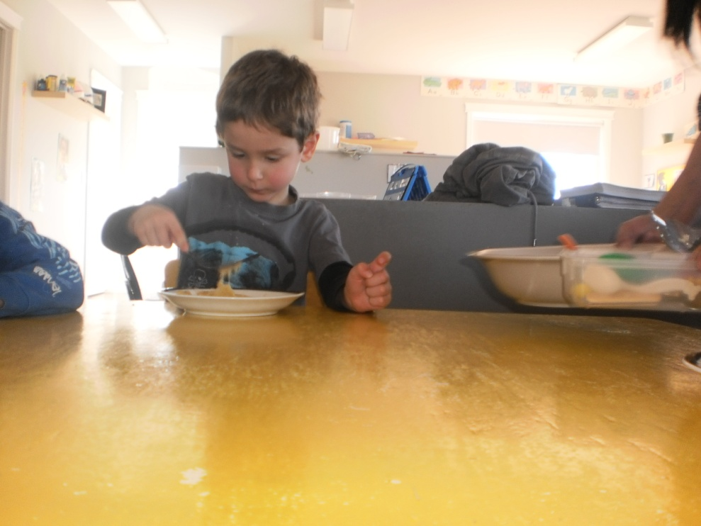
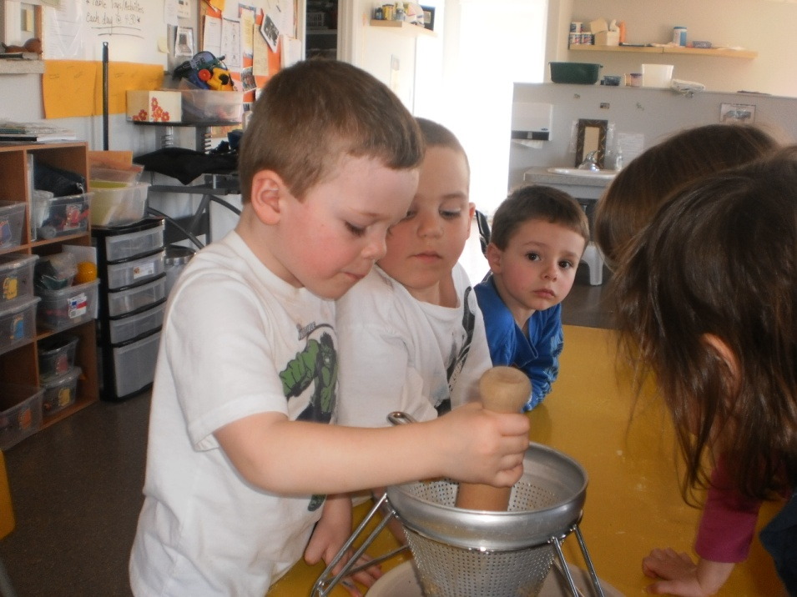
Making & tasting Baby Food

Slide 13
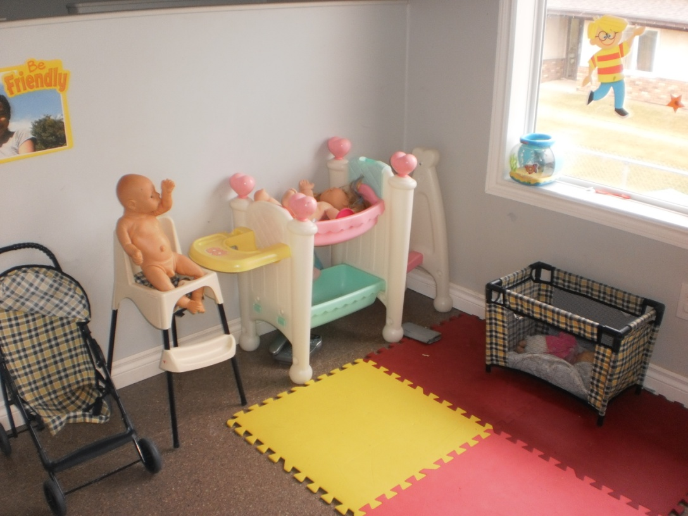
The Nursery
The housekeeping area was converted into a nursery area for the children. Kitchen structures were replaced with strollers, playpens, baby toys, change table, highchairs. Invitation areas were set up to include baby bottles, baby toys, baby carrier, and diapers.
Families and community were included in the form of discussions with parents and sharing of stories. Parents provided baby items for invitation areas. Children’s leanings were represented mainly in the form of dramatic play.

Slide 14
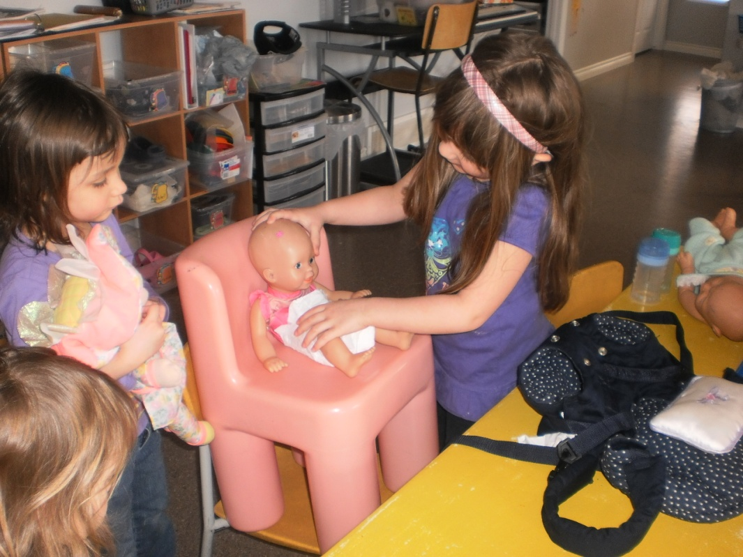
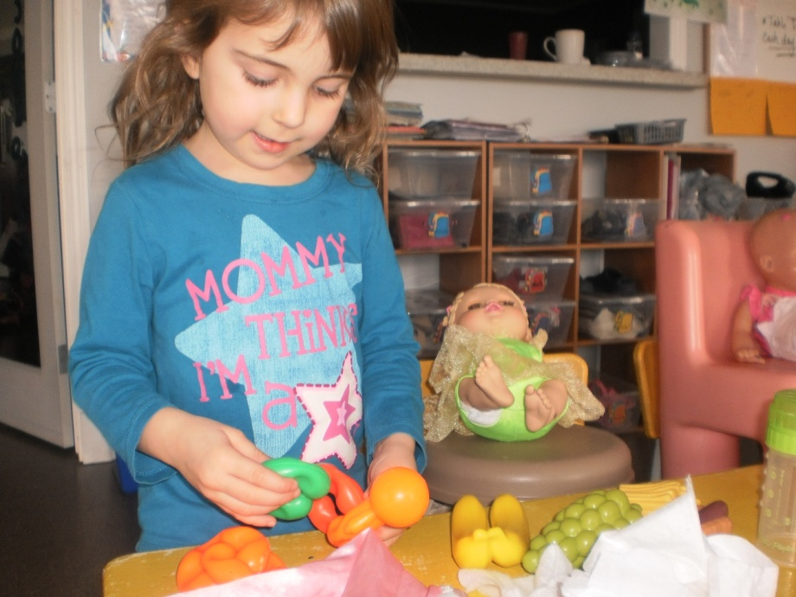
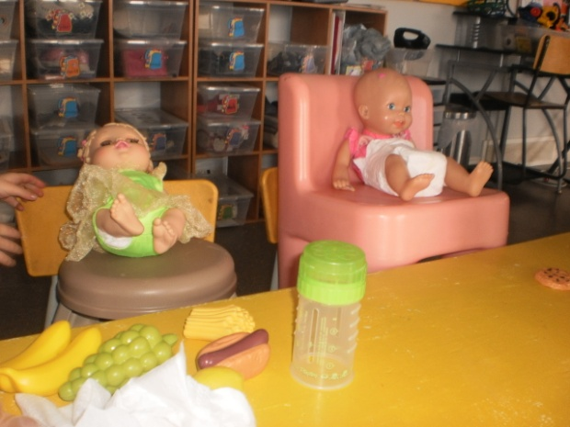
Dramatic Play

Slide 15
Taking the babies for a walk

Slide 16
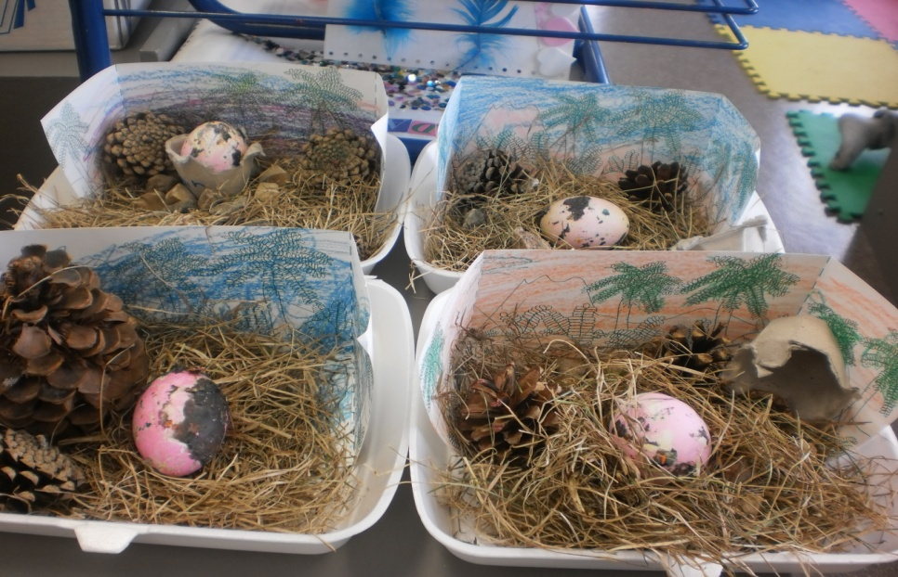
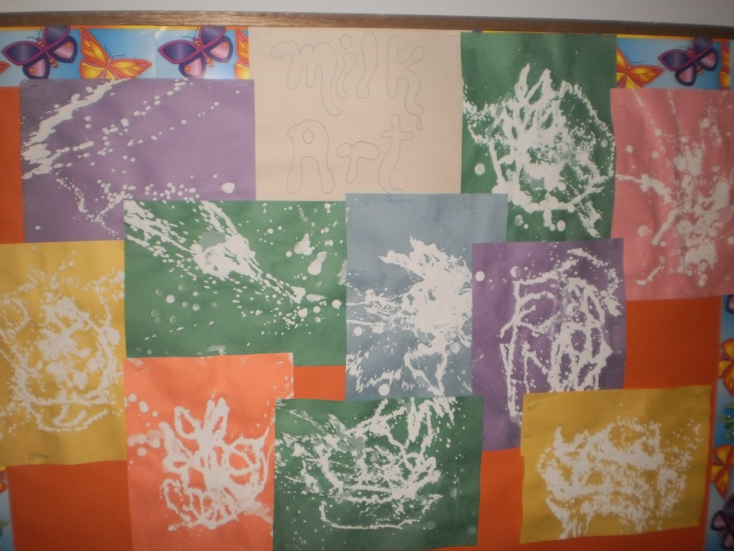
Literature, Art and other Activities
In the area of literacy and music, many stories were read including The New Baby and Robert Munch’s Alligator Baby plus many more talking about babies. We also listened to a CD of lullabies, and classical music.
Some Art activities included eggs crafts, TP babies, constructing nests, coloring pages, rubber glove milking, bird feeders etc. Other activities were making our own baby food to smell and taste as well as sampling a variety of store bought baby food.

Slide 17
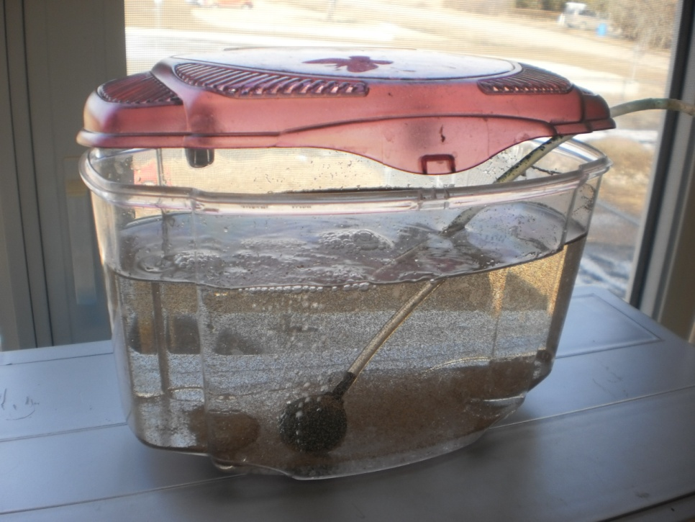
Crafts & Activities
Making Paper Babies
Hatching Brine Shrimp Eggs

Slide 18
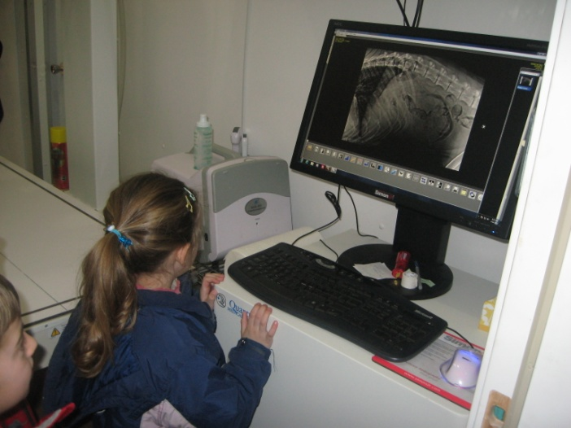
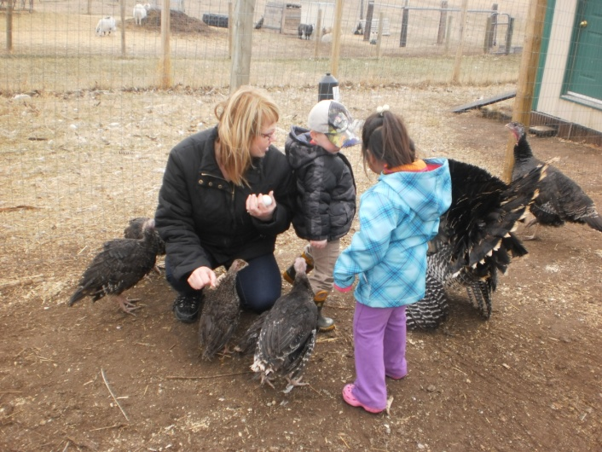
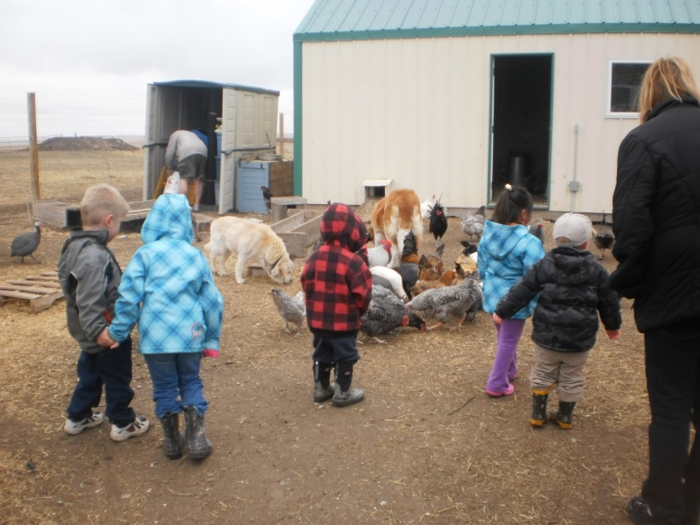
Other outings learning about Animal Babies

Slide 19
Milestones
The children were engaged in a wide variety of activities which contributed to a variety of areas for learning such as
cognitive development, language development,
gender awareness, self awareness and empathy (in caring for their babies)
imagination development
skills used in listening and following directions
fine motor skills and gross motor skills
Social skills, problem solving with friends
Sensory experiences tasting the baby food
The children learned though their own natural curiosity and independence by choosing the direction the project took.

Slide 20
Teacher Reflections
Following the interest of the children promoted greater learning in both teachers and the children as they were eager and curious to learn more. It was very surprising to see how it fostered their natural curiosity, which in turn made us more open as teachers to explore these new options in teaching.
The outings we went on provided the children with so much more learning than just about babies. Other skills used were communication with others, listening and public behaviour in a group (staying together with the teachers), besides cognitive development and learning new vocabulary.
We were surprised at how much the children’s interest in the topic grew, how eager and excited they were to learn more. They still are enjoying the dramatic play area which had been converted to a nursery. The other thing that was surprising was how much the boys got involved in this topic as it was initiated mainly by a few of the girls playing in the housekeeping area. The boys enjoyed using the baby carrier and the diapers. One four year old boy even tried to diaper himself.
This project encouraged individuality and boosted their self confidence. It was interesting when the boys first started exploring the babies and their necessities they appeared hesitant and slightly embarrassed to be playing with the dolls. After a very short time with all the discussions on the topic the boys grew to be a lot more comfortable using the babies and caring for them. The kids learned empathy and compassion in pretending to care for their babies

