Slide 1
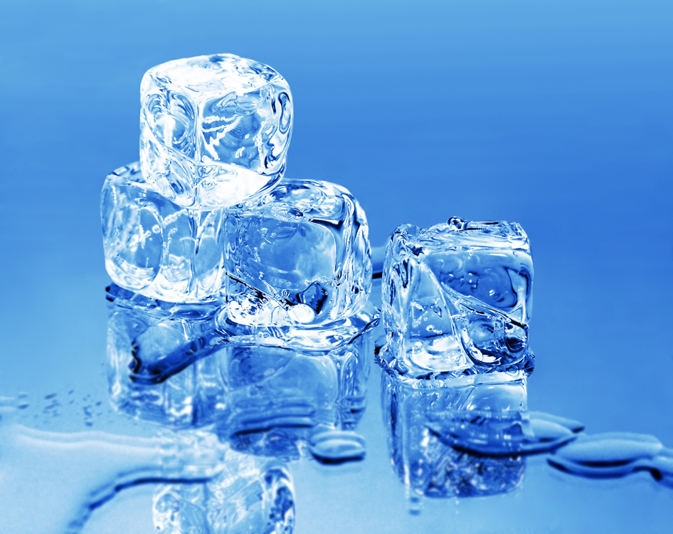
THE ICE PROJECT
BY Kara and Andrea

Slide 2
Information
The age of the children who participated in the ice project were between the ages of 3 and 10 years of age and about 12 were involved. Children ranged from drop in, part time to full time. The staff were Kara Karmos and Andrea Friesen.
The project began while on a walk in the neighborhood with the children. They started stepping and stopping on a frozen puddle and while doing this they started asking questions about the ice. When we arrived back at the daycare the children and staff designed a project web. They talked about ice and how it is made and used in ice sculptures and ice rinks.

Slide 3
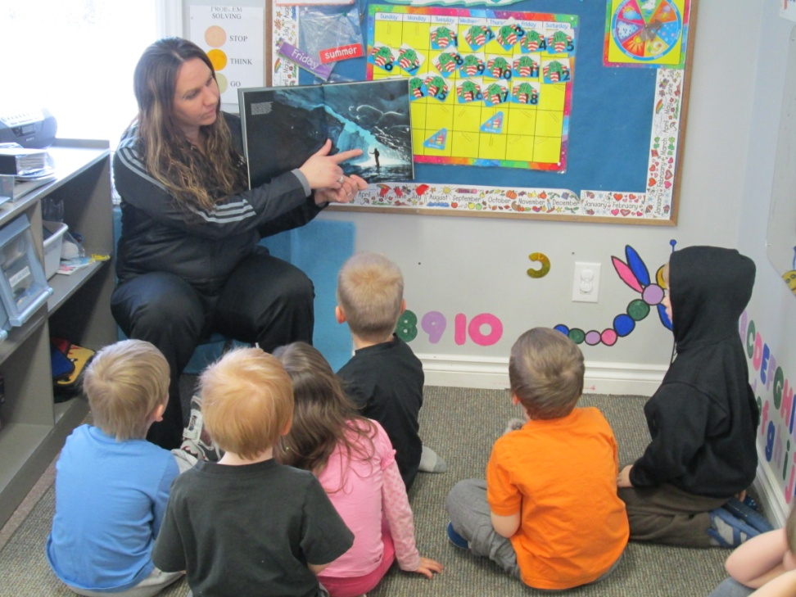
The Beginning
The project began while on a walk in the neighborhood with the children. They started stepping and stopping on a frozen puddle and while doing this they started asking questions about the ice. When we arrived back at the daycare the children and staff designed a project web. They talked about ice and how it is made and used in ice sculptures and ice rinks.

Slide 4
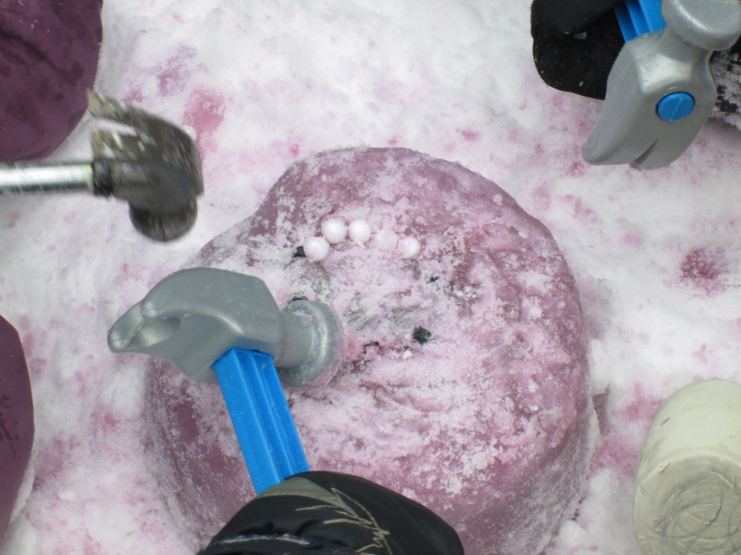
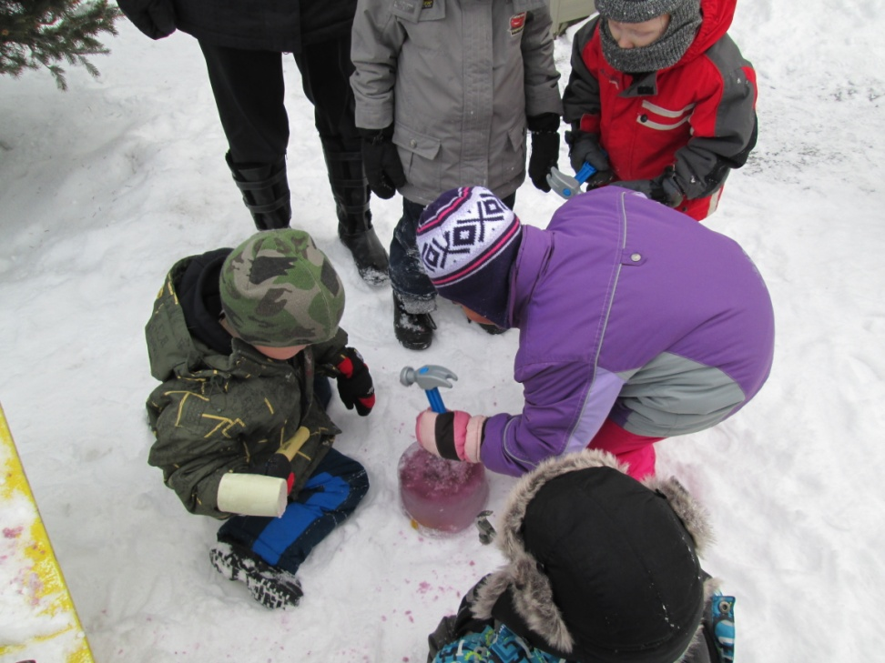
Ice in Pails
The following days of the project turned into children freezing ice in pails and balloons to make ice sculptures.
. After the ice was frozen in the pail we took tools outside with us and the kids made their own project. Some of the children smashed the ice

Slide 5
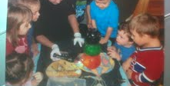
a snowman out of the balloon ice.
“ What is going to happen when we put salt on it?
“Melt, explode, stick or be shiny”

Slide 6
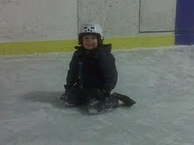
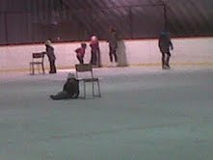
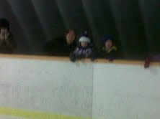
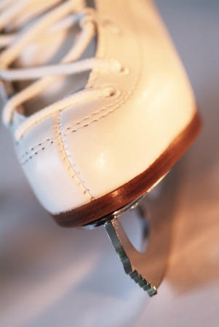
The children visited the local ice rink
And interviewed the caretaker Gary, he talked about the rink and how it’s cared for and made. Afterwards the children got on their skates and went skating. The parents were asked to be involved in this outing.

Slide 7
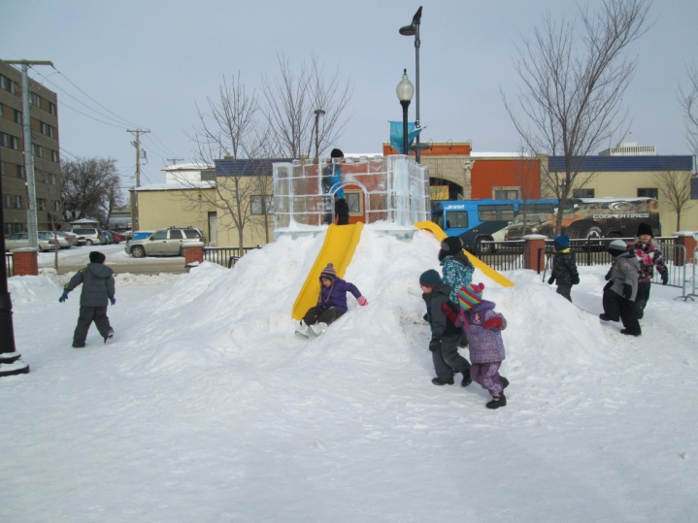
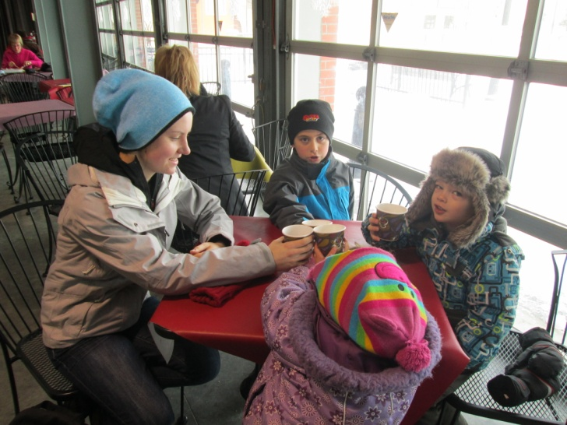
A field trip was to Saskatoon’s Winterfest at the local Farmer’s Market.
The children enjoyed looking at the sculptures, playing in ice and playing on the ice slides. Afterwards the parents joined us for apple cider inside the farmers market. The day was very exciting for everyone.

Slide 8
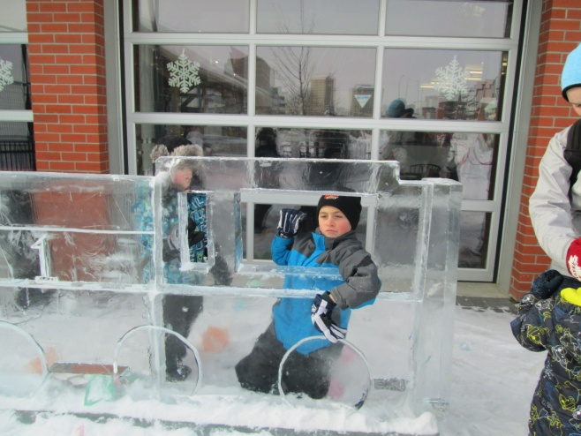
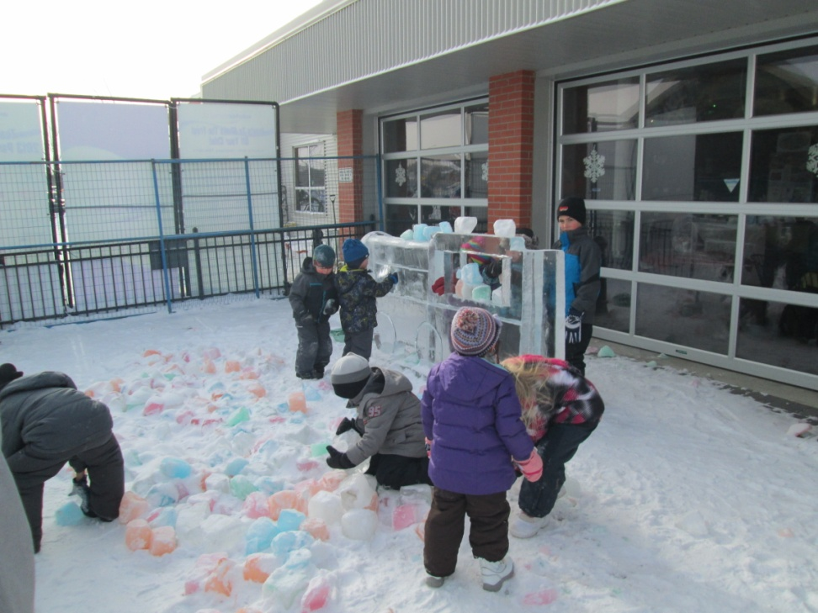
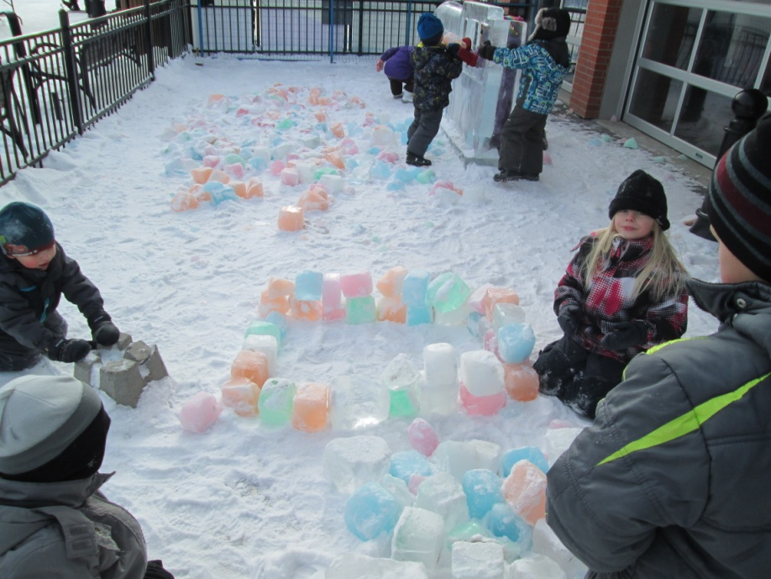
Ice Fun At Winterfest
Fun with friends
Brrr cold

Slide 9
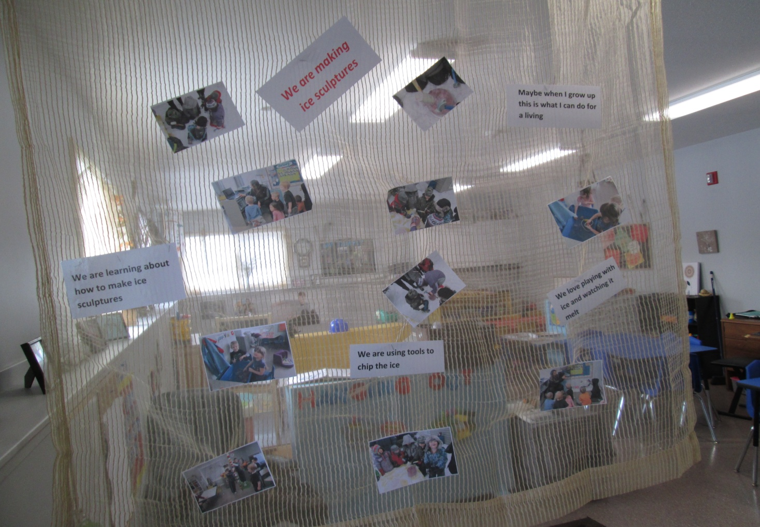
The project was concluded with a web, pictures and jot notes posted in the classroom for other staff, professionals and parents to view.

Slide 10
As a teacher I learned that a project could begin with something as small as a ice puddle and expand into something bigger as a rink or ice sculptures. The ice project was a good and interesting topic for everyone involved. It was a great topic to be able to involve all the daycare, parents, and community as a group.

Slide 11

The Ending
The project ended on the last day the local rink was open with one last skate and valentine’s day arrived. Just before valentine’s day the kids interests changed to talking about valentine’s day instead of ice.

